Slide 1
THE IMPACT OF AI ADVANCEMENTS ON U.S. STOCK MARKETS: A CORRELATIVE STUDY OF AAPL, FB/META, GOOGL, & MSFT BY ALEXANDER, ANAND, CAMERON, JEAN, USHA OCTOBER 22, 2024

Slide 2



Sampling Plan:
Apple, Google, Facebook/META, Microsoft
S&P 500 Index, NASDAQ Composite Index
Hypothesis: Advent of AI has Positively Impacted leading Technology Companies and the Stock Market
Sample Size:
1/2018 – 9/2024;
ChatGPT Release – 9/2024;
Gemini/Bard Release – 9/2024;
Copilot+ Release – 9/2024
Data Sources:
Alpha Vantage, Yahoo Finance
Kaggle
Outputs:
Total Returns
Annualized Returns
Stock Price after Each Release
Traded Volume after Each Release
Predictions over next 12-months

Slide 3
Project Flow
Define and Agree Objectives
Determine Input and
Output Parameters
Conduct Research to Determine
Milestones/Key Dates
Research Alternate Sources –
Not All Sources Complete with Data
Source Data
Import Data in VS Code
Develop Code to Create
DataFrames and Organize Data
Refine Code for Formatting
Refine Queries for
Complete Understanding
Compute Predictions for
Forward 12 Months
Compare Outputs against
Hypothesis
Analyze Data
Summarize Outputs

Slide 4
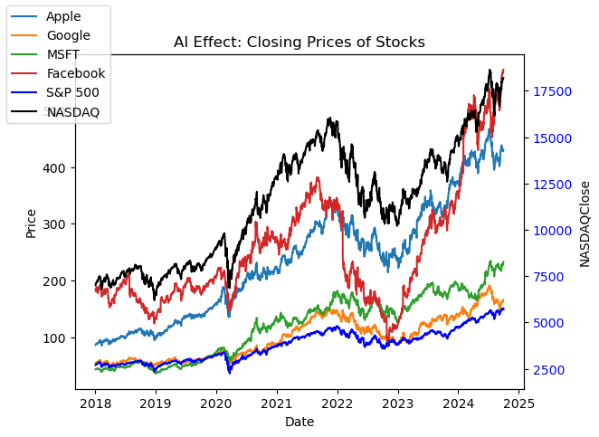
The Growing Role of AI in the Stock Market
Importance of AI in Shaping Financial Markets
Description of time frame, price fluctuation pattern, similarities
Focus on key companies: Apple, Meta, Google, Microsoft

Slide 5
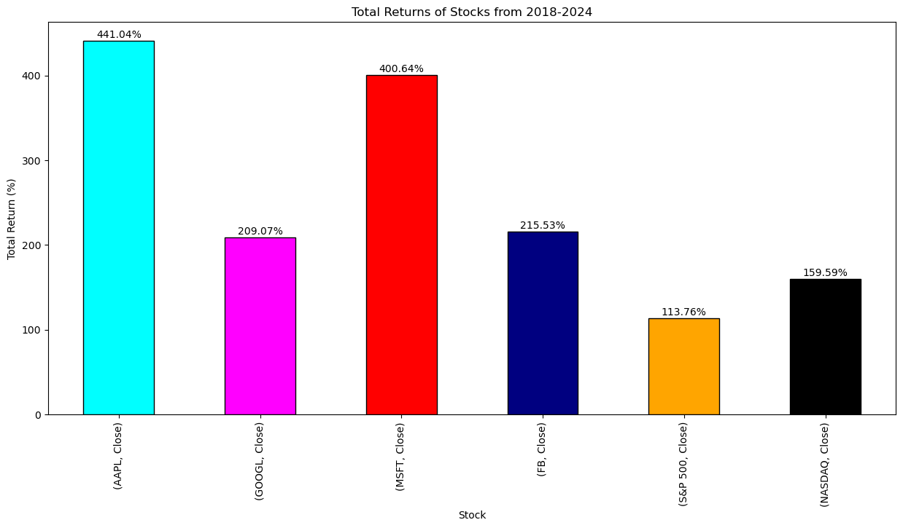
Why AAPL, FB/META, GOOGL, & MSFT?
Leaders in AI innovation and commercialization
Releases of key AI products (ChatGPT, Gemini/Bard, Microsoft Copilot+)
Significant influence on U.S. stock markets

Slide 6
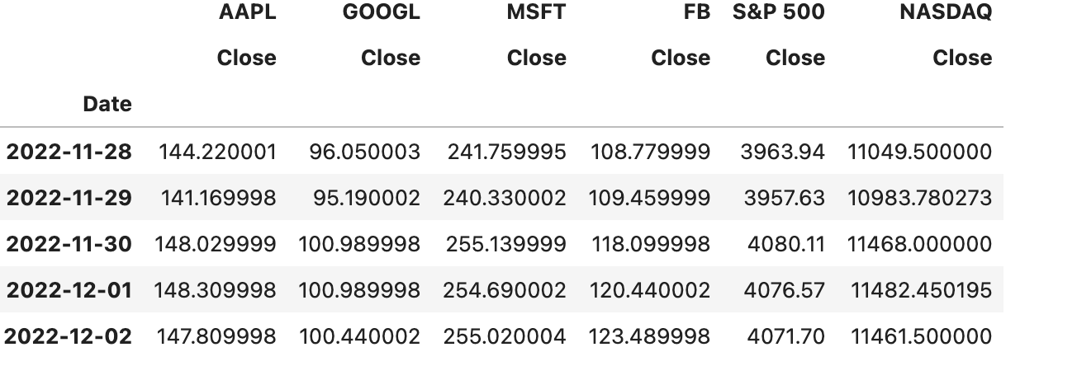
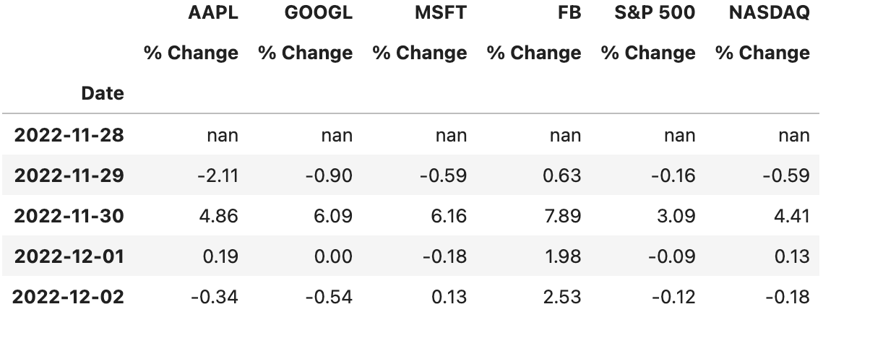
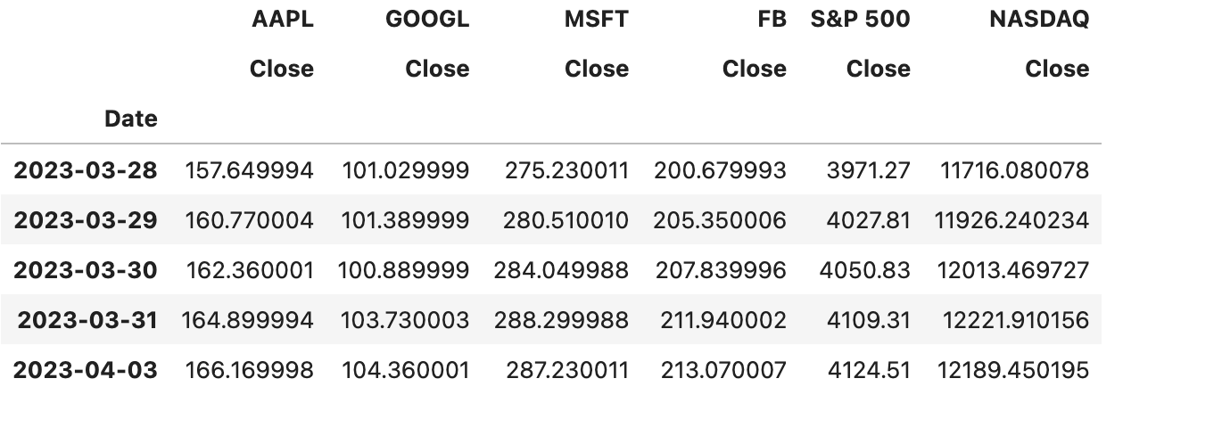
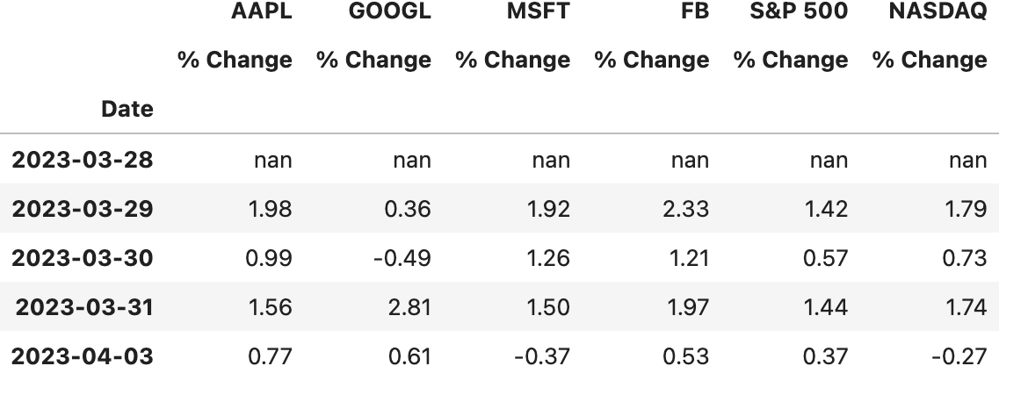
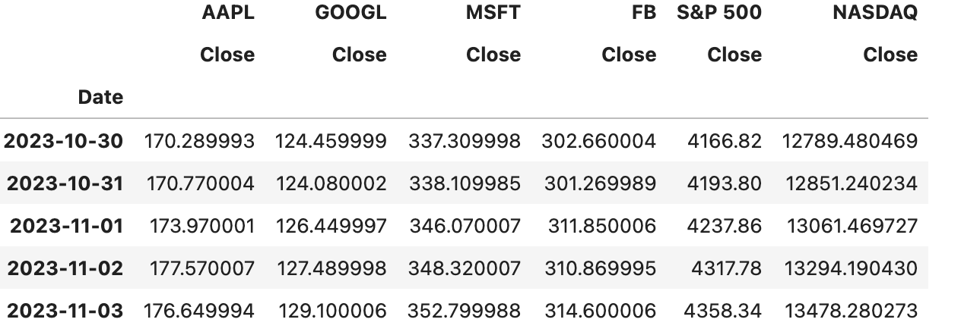
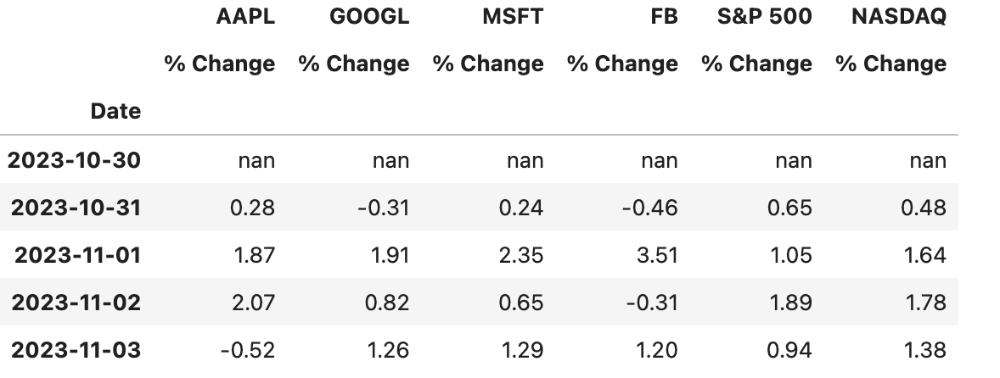
Release day Impact of Major AI Products
OpenAI’s ChatGPT
Google’s GEMINI/BARD
Microsoft’s CoPilot +
Open AI’s ChatGPT’s Nov 28-Dec 02, 22 release
Google’s Gemini/Bard’s March 30-April 03, 23 release
Microsoft’s Copilot’s Oct 30-Nov 03, 23 release
Each release increased trading volume, rate, and stock value

Slide 7
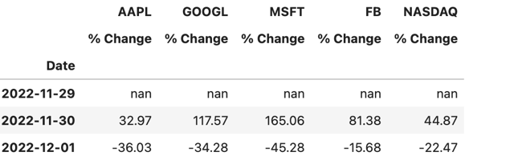
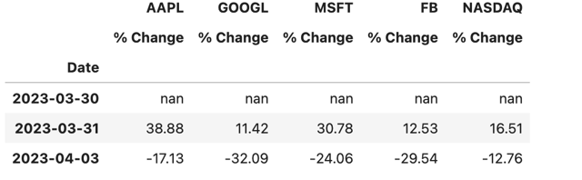
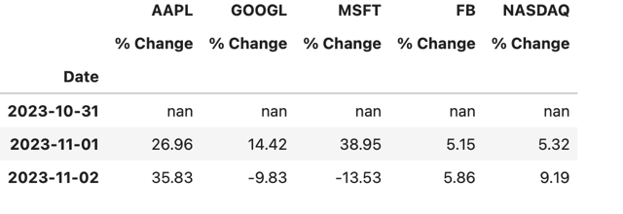
Market Impact of Major AI Product Releases
ChatGPT (late 2022) and integration with Microsoft Copilot+
Google’s Gemini/Bard and its Impact on search and advertising
Meta's AI algorithms driving platform engagement
Each release increased trading volume, rate, and stock value (white background)
TRADING VOLUME% IMPACT OF CHATGPT
TRADING VOLUME% IMPACT OF GEMINI/BARD
TRADING VOLUME% IMPACT OF COPILOT +

Slide 8
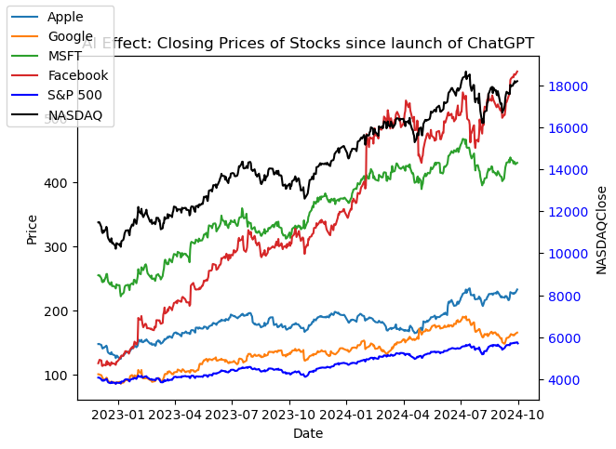
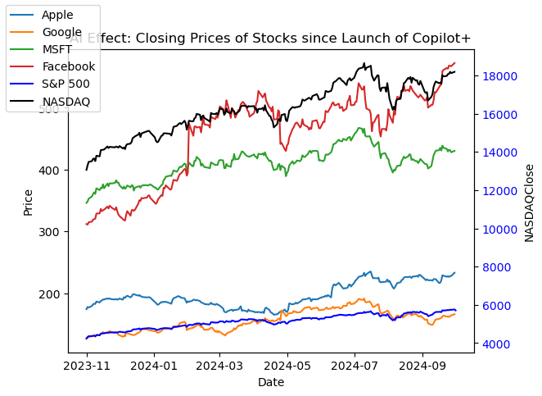
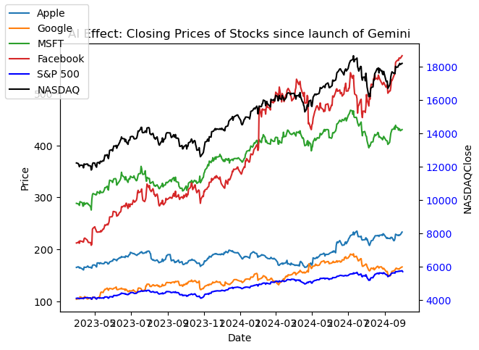
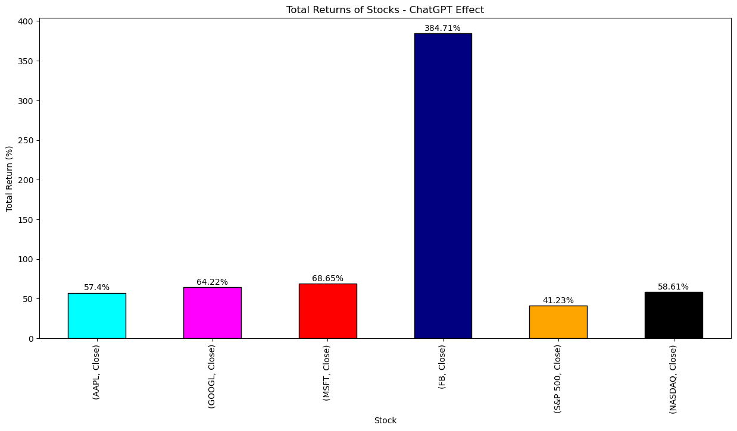
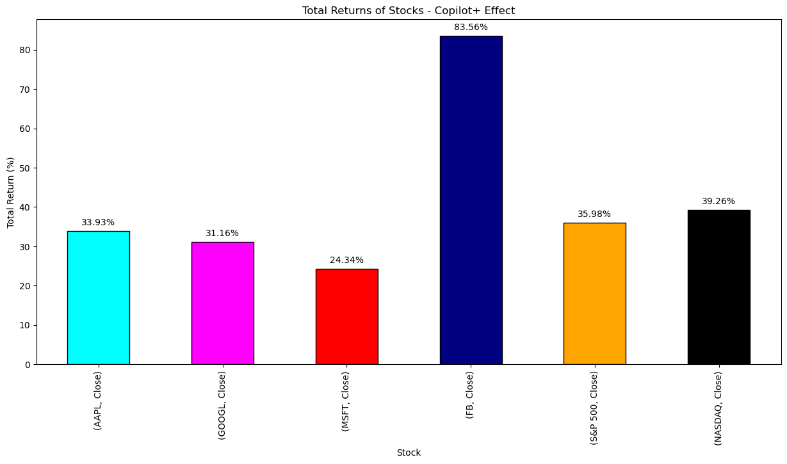
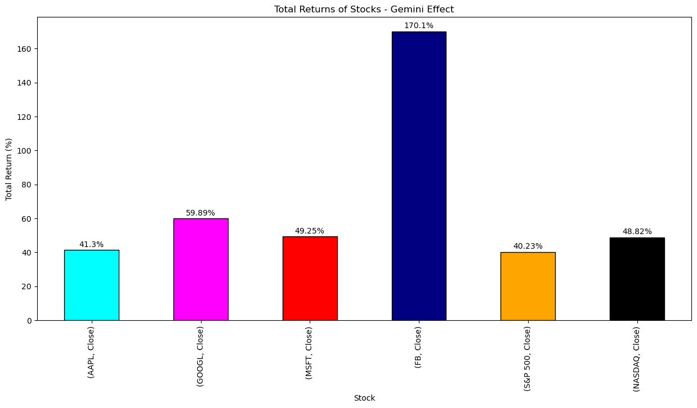
Correlation with Stock Market Performance
Stock price trends during major AI announcements
ChatGPT, Gemini/Bard Increased trading volumes and positive investor sentiment
Outperformance of AI-focused companies

Slide 9
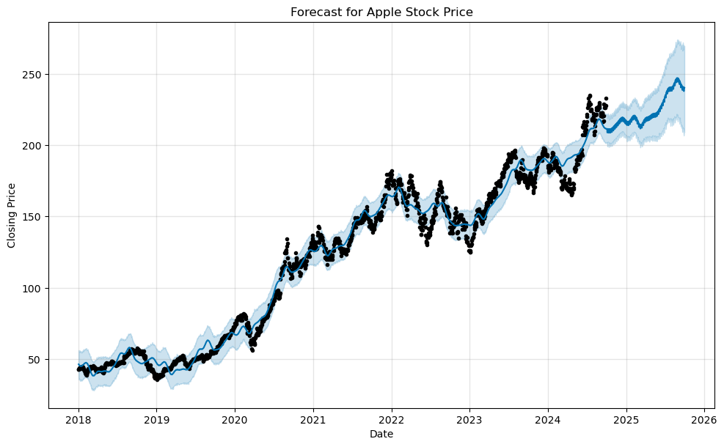
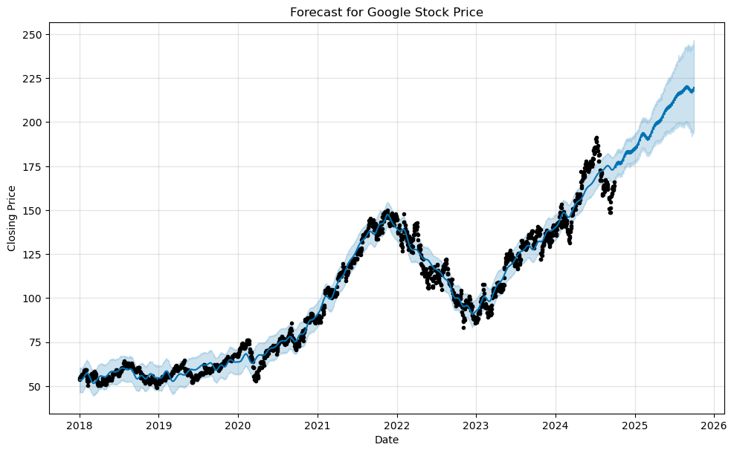
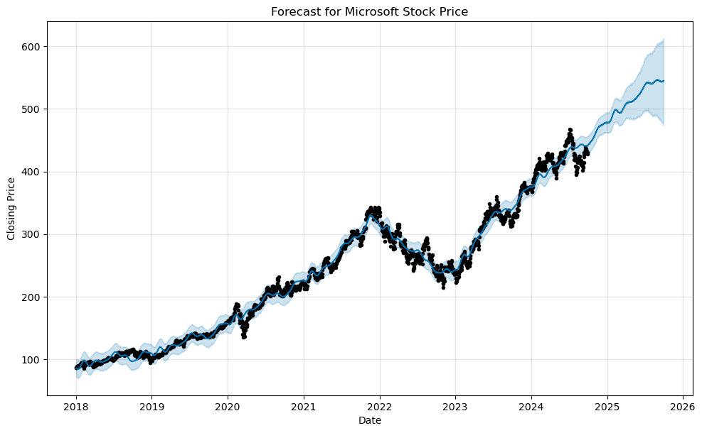
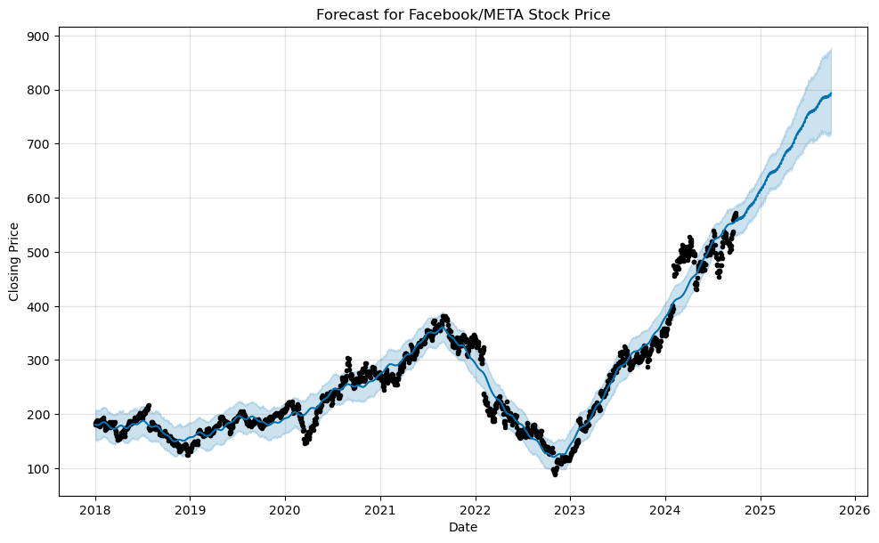
The Future of AI in Stock Markets
AI’s Growing Role in Stock Performance Through Innovation
Key factors for investors: monitoring AI products, regulations, market trend
Projected stock futures of AI leaders Microsoft, Google, Apple and Meta

Slide 10
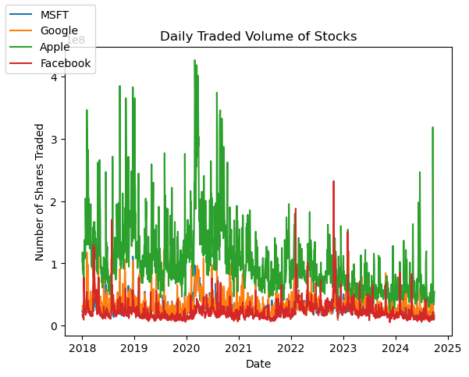
AI Advancements, Volatility, Risks
Ethical and regulatory concerns around AI
Market volatility following controversial AI developments
Stock declines during negative AI-related news

Slide 11
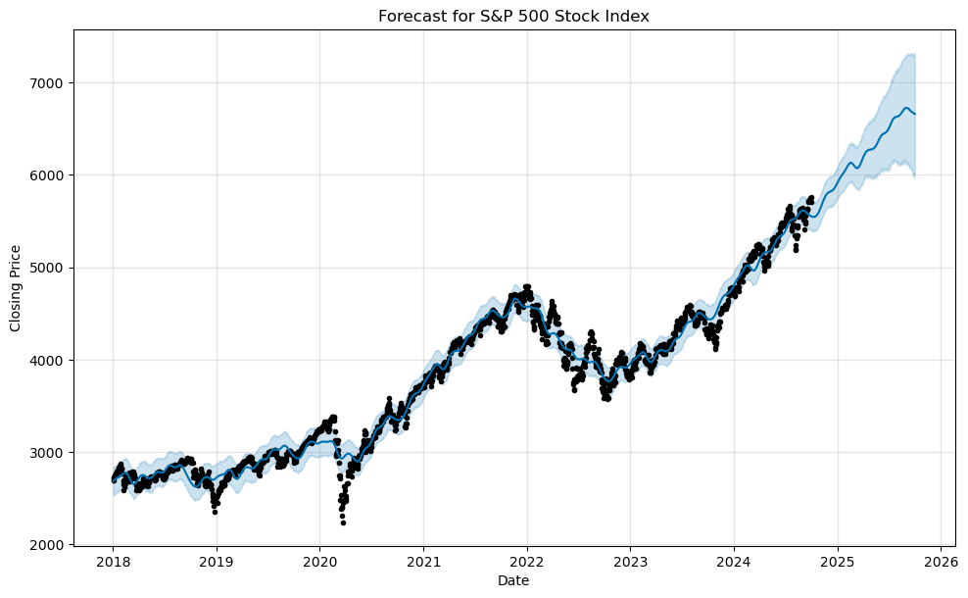
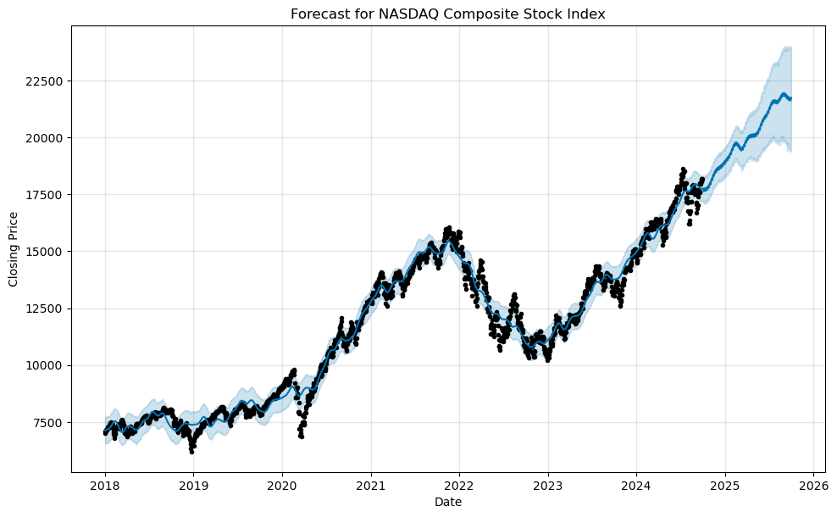
Investor Optimism on AI Advancements
AI product releases driving market momentum
ChatGPT’ s integration boosting MSFT
Gemini/Bard impacting GOOGL
Correlation between AI news and trading volumes of S&P 500 and NASDAQ

Slide 12
Key Takeaways and Reflections
AI product releases (ChatGPT, Gemini/Bard, Copilot+) are major drivers of stock performance
Companies leading AI innovation show strong market results
Investors should closely monitor AI trends and regulations for future growth potential
Global markets, politics
Global AI trends
Global black swan events
Future focus
AI chips and hardware for quantum computing
AI-enhanced cloud solutions
Autonomous driving
Fintech AI
Personalized healthcare

Slide 13
References
Alpha Vantage
Bloomberg LP
Kaggle
Yahoo Finance

